Slide 1
Real-Time News Impact on Financial Markets
Team Project By
Deepeka Gurunathan-11808448​
Maybel Hernández-11648993​
Srija Gouda-11704883​
Surya Bhargav Yamarthi-11666310​
ADTA 5240 - Harvesting, Storing and Retrieving Data Department of Advanced Data Analytics, University of North Texas

Slide 2
Project Objective and Data Lifecycle
Project objective:
To analyze historical and real-time financial market data from financial platforms to reveal stock market trends and patterns that can aid in better investment strategies. Also, to uncover the relationship between real-time news and stock performance in real-time.
Data Lifecycle:
In this project, we follow the eight-step data life cycle process to collect, process, analyze, and interpret the data. Here are the eight phases of the data lifecycle.
1. Data Generation
2. Data Collection
3. Data Processing
4. Data Storage
5. Data Management
6. Analysis
7. Visualization
8. Interpretation
The data life cycle holds the key to managing and optimizing a real-time news impact project and for analyzing news coverage of any event for its impact on an outcome, like stock prices or sentiment. The data life cycle ensures that, from data collection to decision-making, all steps are handled efficiently to get timely and relevant insights.

Slide 3
Data Sources
We have considered three types of data sources for this project: Historical stock data, Real-time stock data, Real-time news feeds.
To collect static and streaming data for analyzing the real-time news impact on the financial market, we picked the financial data from Yahoo Finance, which is a reliable financial platform that contains both static and streaming data. The website includes information such as stock prices, trading volumes, and other historical financial metrics, as well as market trends.
For real-time news feeds, we have selected Finviz.com, an ideal stock screening platform that has a variety of features to help investors and traders learn about the stock market.
Historical financial market data contains stock details of versatile tickers(stocks) such as Apple, Microsoft, Tesla, CVS, Netflix, and NVDA from year 2022 to 2023. And the data is collected through yfinanceAPI Python code.
Data source: https://finance.yahoo.com/lookup
2) Real-time data contains each stock open, and close price that are retrieved from Yahoo Finance through Alpha Vantage API Python code.
Data source: https://finance.yahoo.com/quote/TSLA/
3) For sentiment analysis, the real-time news with sentiment scores is scraped from Finviz.com through Alpha Vanatage API using Python code.
Data source: https://finviz.com/

Slide 4
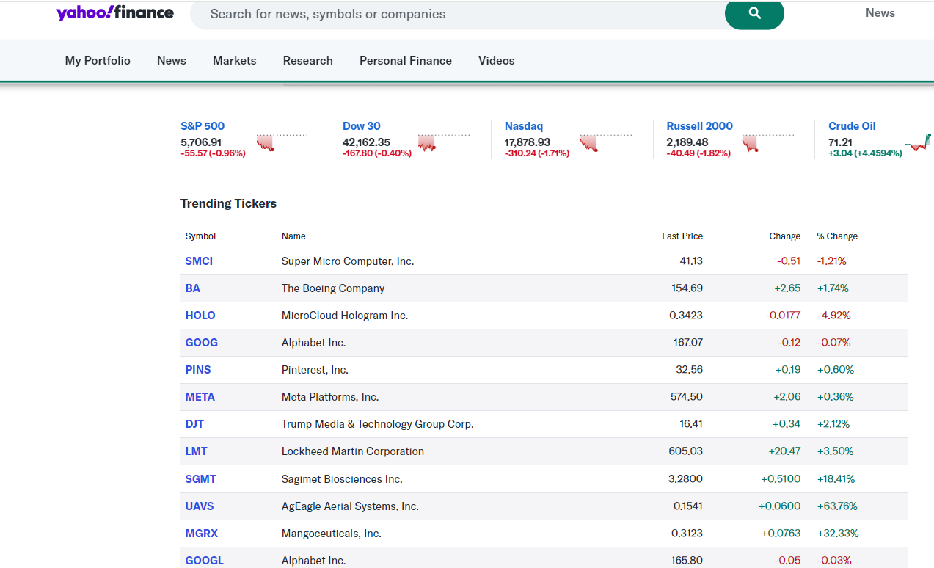
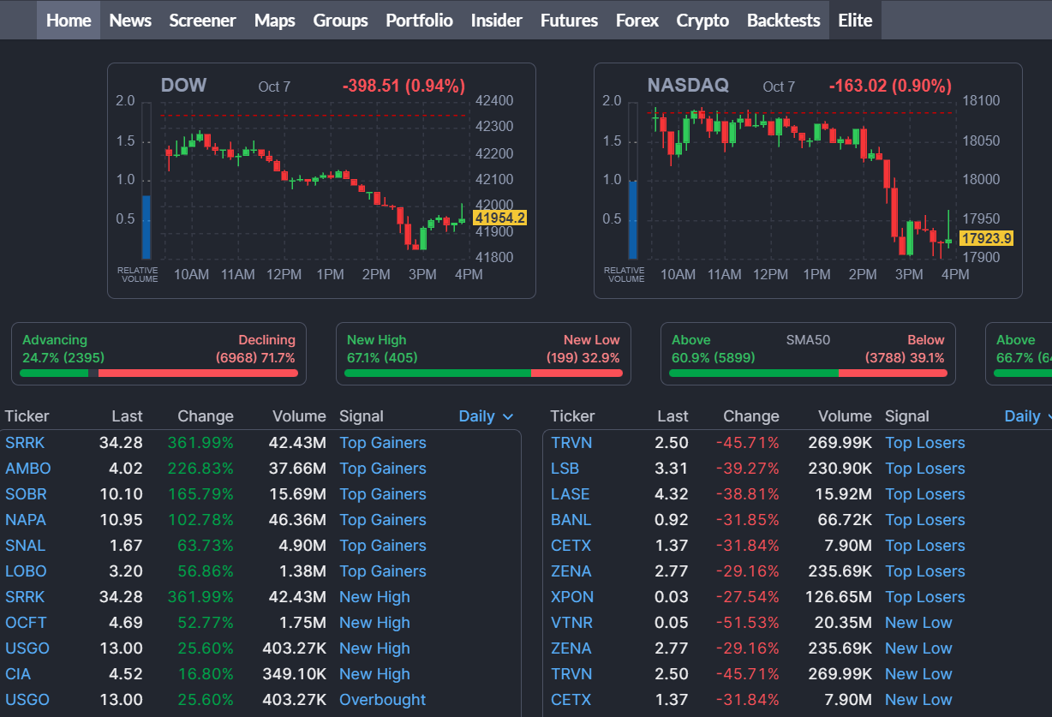
Data Creation/Generation
Data generation is the first step in the data life cycle, and it's already happened. For our project, we retrieved the data from Yahoo Finance, the financial platform, since it contains both historical financial market data and real-time stock data and meets the project requirements.
Fig 1-a sample of the stocks listed in yahoo finance.
Fig 2-a sample of the real-time news feed for sentiment analysis listed in Finviz.

Slide 5
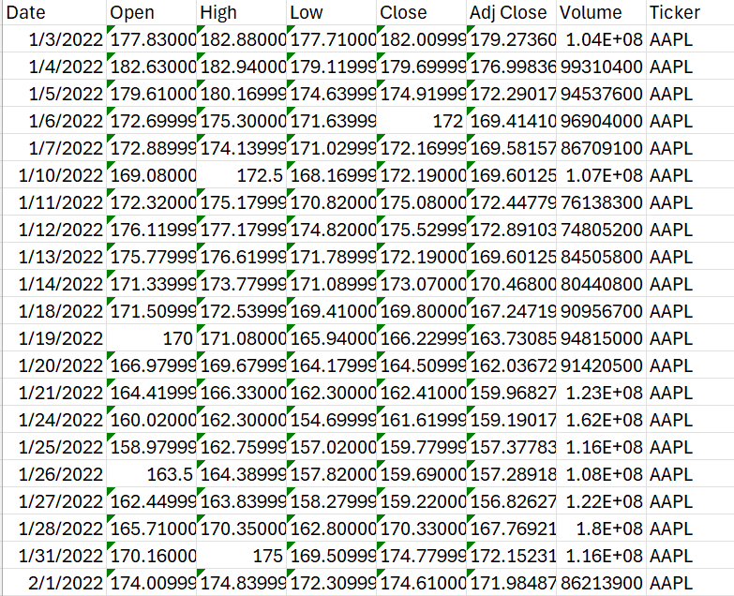
Data Collection
For this Project, we collected three types of data: Historical stock data, Real-time data, and Real-time news data for sentiment analysis.
Static Data Collection : Historical Stock Data - To start the data collection process, we collected the stock data for the stocks such as Apple, Tesla, Microsoft, Netflix, NVDA, and CVS from 2022 to 2023 through Yahoo Finance API using Python.
Fig 3-represents the snippet of the historical stock data (2022-2023) retrieved using the python code.

Slide 6
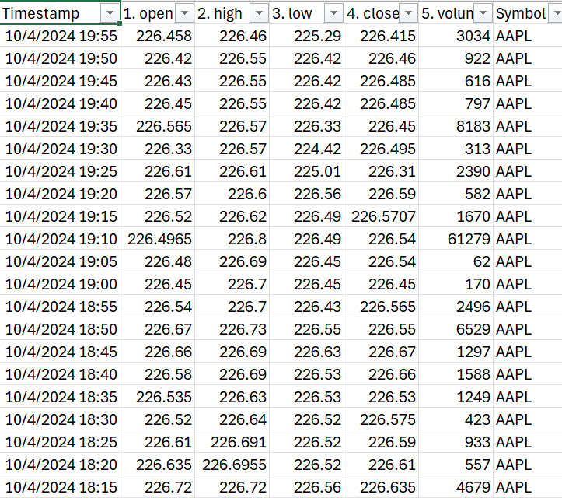
Streaming Data Collection : Real-time Stock Data
For sentimental analysis, we retrieved the real-time stock data for stocks such as Apple, Microsoft, NVDA, TSLA, and CVS for sentimental analysis through the Alpha Vantage API key using Python. The sentiment score is calculated based on the Vader sentiment analyzer tool to analyze the expression as positive, neutral, or negative.
Fig 4-represents the real-time stock data retrieved using the python code.

Slide 7
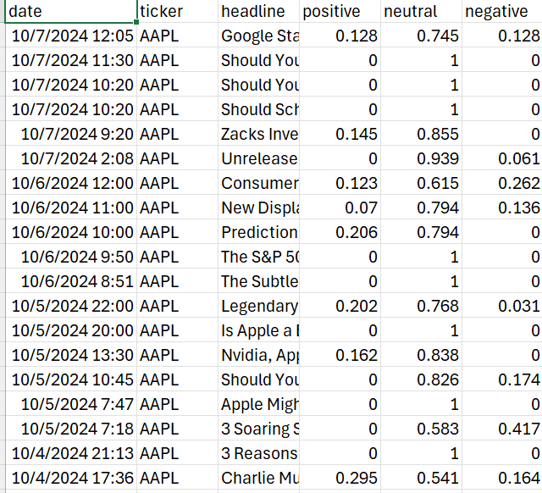
Streaming Data Collection : Real-time Stock News
For sentimental analysis, we retrieved the real time news for sentimental analysis through the alphavantage API key. The sentiment score was calculated based on the Vader sentiment analyzer tool to analyze the expression as positive, neutral, or negative.
Fig 5-represents the snippet of the real time news data retrieved using the python code.

Slide 8
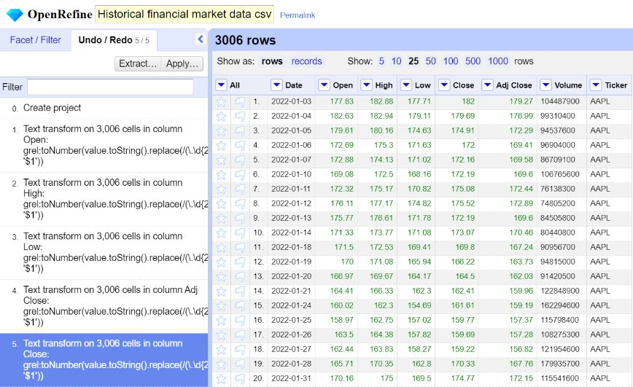
Data Processing
As part of data processing, we cleaned the datasets using OpenRefine for further analysis. First, we considered historical stock data for data cleaning process.
Static data source: Historical_financial_market_data.csv file is explored for data cleaning purposes.
Observations:
No null values present.
No datatype mismatch.
No outliers present.
Datatype consistency.
Steps Taken:
Rounded decimal values to two places for open, high, low, close, and adj close prices to maintain data consistency.
Fig 6-represents the snippet of the OpenRefine tool in which the historical stock data is processed to round the decimal values to two decimal values.

Slide 9
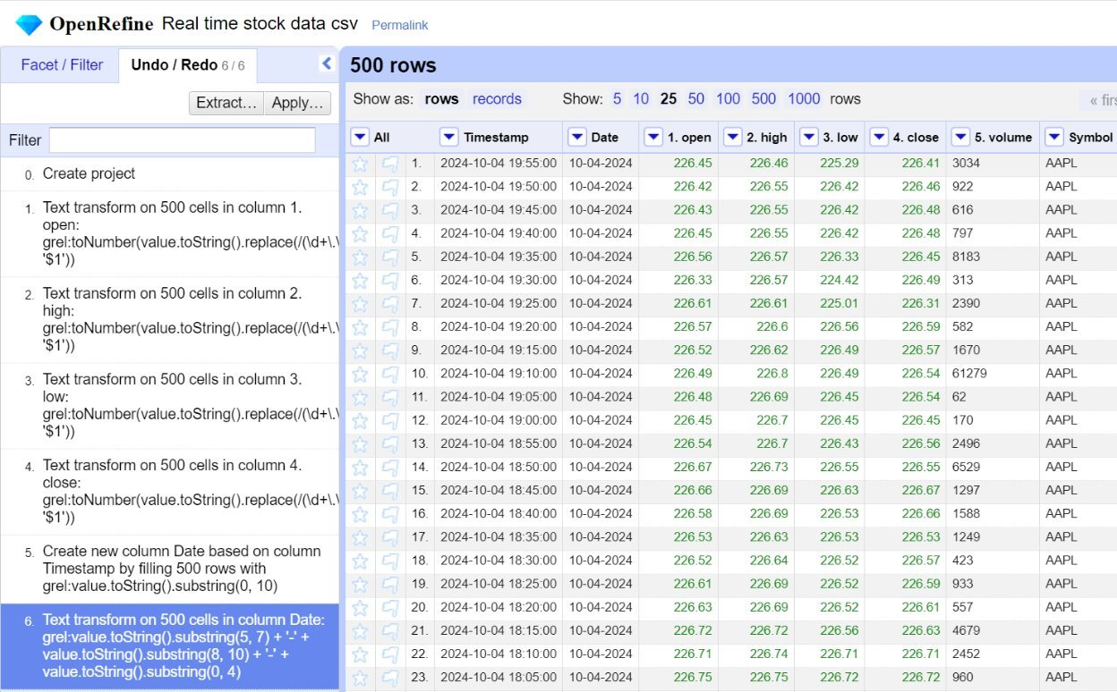
Streaming data source: Real Time Stock data.csv file is explored for data cleaning purposes.
Observations:
No null values present.
No datatype mismatch.
No outliers present.
Date and timestamp is found together.
Steps Taken:
Rounded decimal values to two places for open, high, low, and close prices to maintain data consistency.
Created a new column named date and extracted the date values to the new column.
Fig 7-represents the snippet of the source code to harvest the real time stock data as part of stream processing.

Slide 10
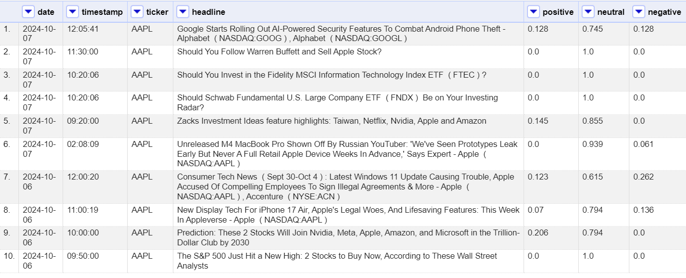
Streaming data source: Real-time Sentiment_news.csv is explored for data cleaning purposes.
Observations:
No null values present.
No datatype mismatch.
No outliers present.
Date and timestamp is found together.
Steps Taken:
Rounded decimal values to two places for open, high, low, and close prices to maintain data consistency.
Created a new column named timestamp and extracted the timestamp values to the new column.
Fig 8-represents the snippet of the source code to harvest the real-time stock data as part of stream processing.

Slide 11
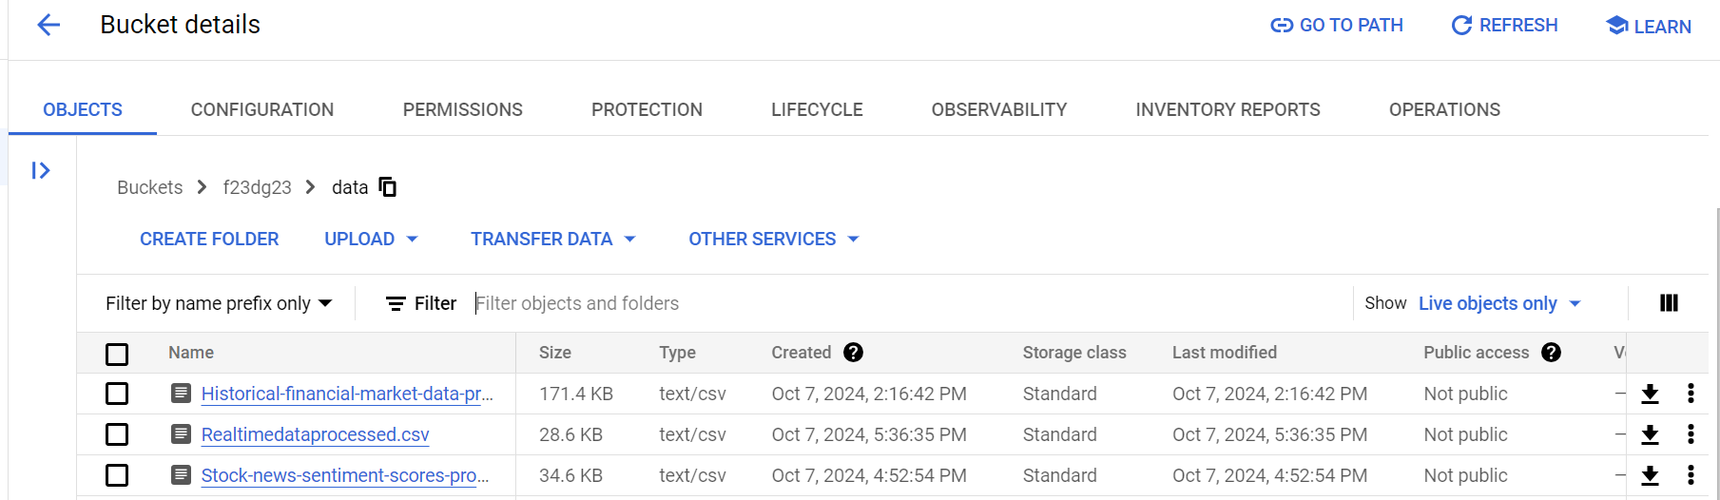
Storage
Once the data was cleaned, the data was stored in the local or cloud platform. In our case, the processed data was stored in the Google Cloud Platform (GCP) Bucket for further transformation.
Fig 9- represents the snippet of the Google Cloud Platform where the three datasets is uploaded to the data folder in GCP Bucket.

Slide 12
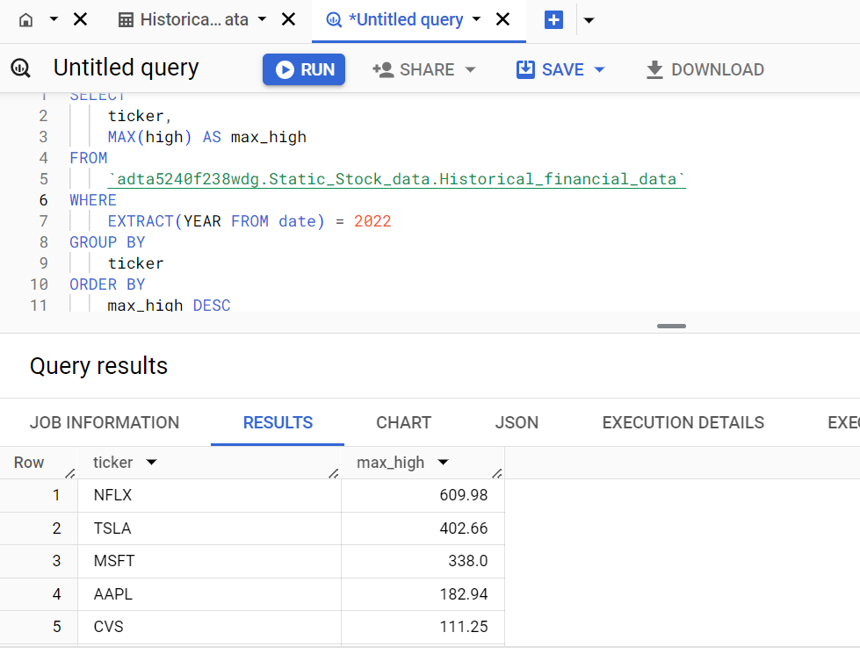
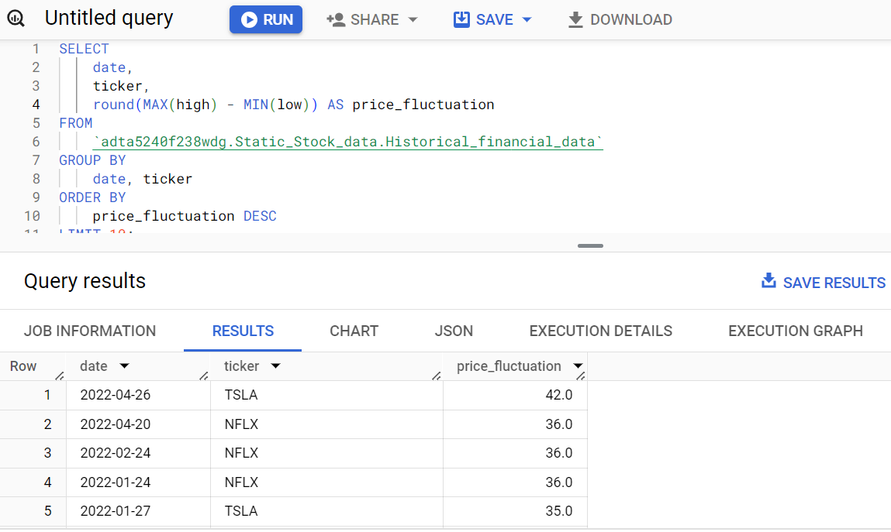
Data Analysis
BigQuery
As part of the Data Analysis, we used Google BigQuery to extract useful information from historical stock data.
Fig 10- shows the top 5 stocks based on high prices in 2022, which reveals Tesla holds the maximum high stock price.
Fig 11- shows the stocks with price fluctuations in 2022, and Tesla and Netflix have the highest number of price fluctuations.

Slide 13
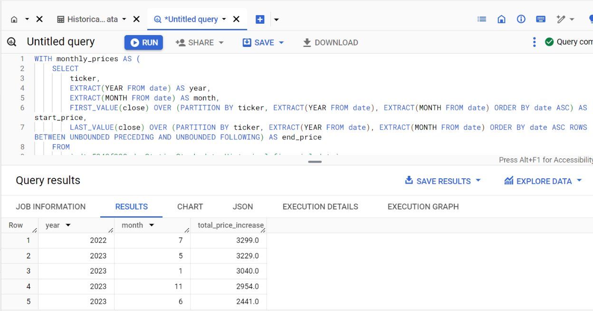
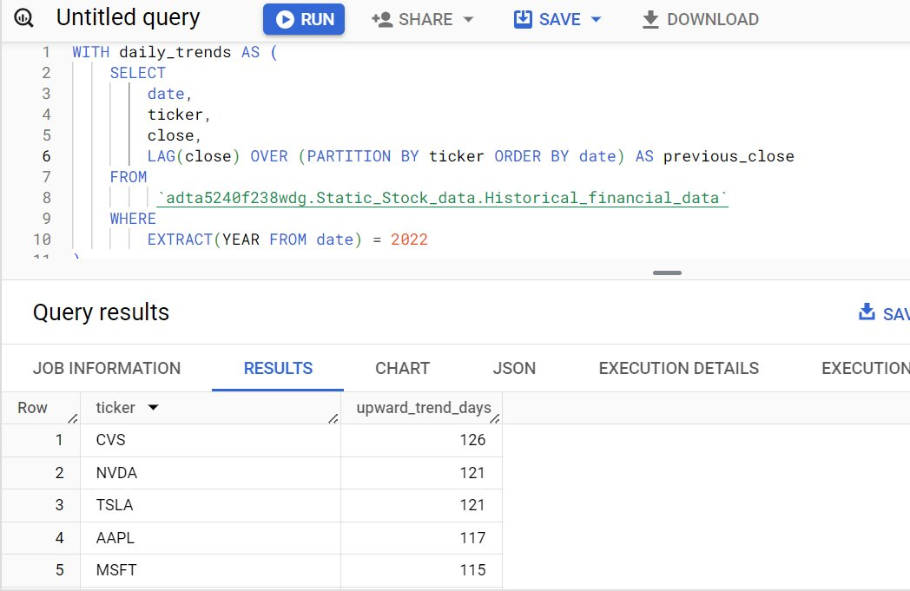
BigQuery
Fig 12-shows the stock price increase based on months in the year 2022, 2023. This will help us to identify the stock price growth over the months.
Fig 13-shows the top 5 which has upward trend days and CVS stays at the top in the year 2022, which reveals CVS holds the stock growth up to 126 days.

Slide 14
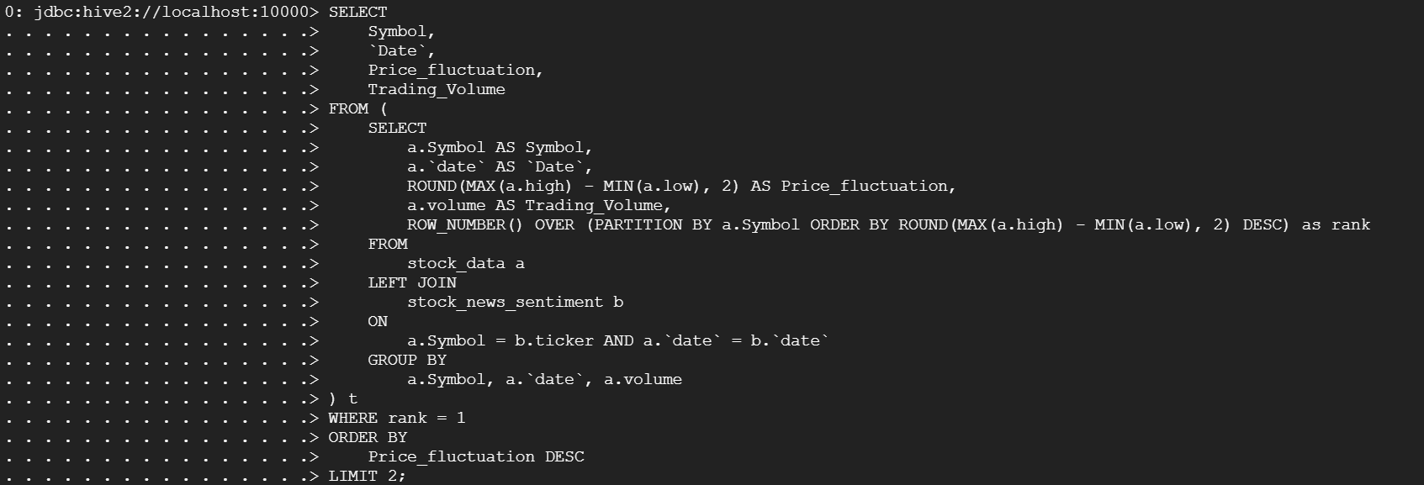
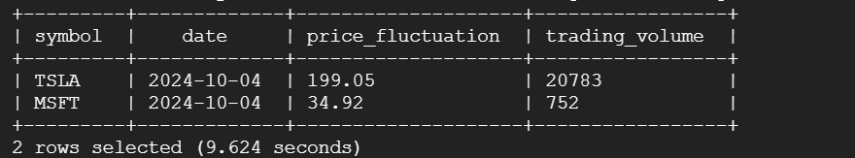
Hive
After analyzing the historical data, we moved to the real-time stock data analysis in Hive.
We have created two tables known as Real-time stock data and Real-time Stock news sentiment and combined the tables using the join condition on the stock name (ticker). Using Hive Query, we found the top two stocks with highest price fluctuation on October 4th, 2024.
Fig 14-the SQL code for joining two tables such as real-time stock data and real-time stock news to retrieve the stocks with highest price fluctuation by matching the stock and date field.
Fig 15-the output for the above Hive Query, and it clearly shows that Tesla and Microsoft has highest price fluctuation on the same day.

Slide 15
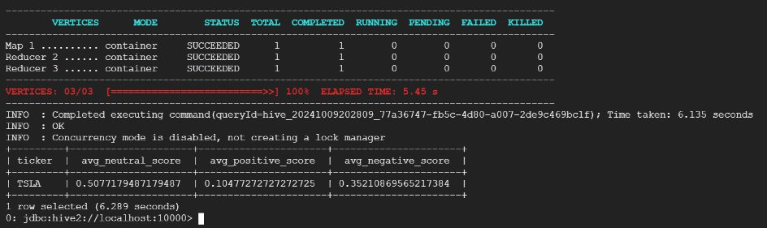
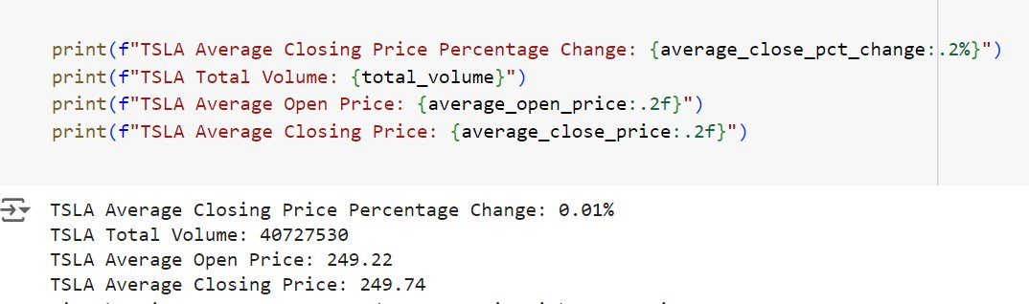
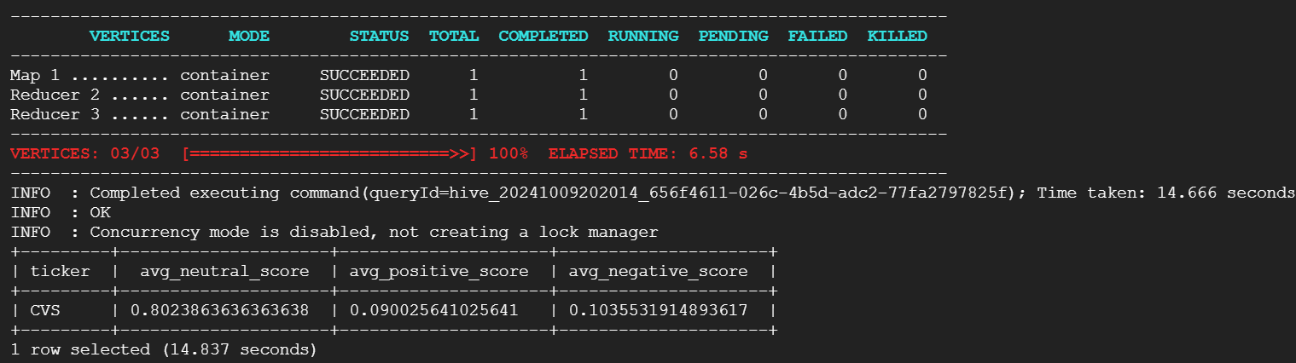
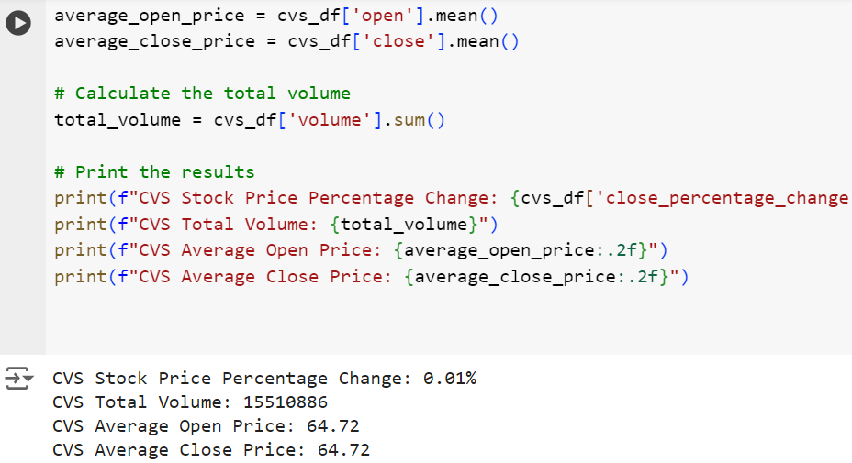
Fig 16-The above bar chart represents the average positive sentiment score for each stock. From the above chart, we can understand that Tesla has the highest average positive sentiment score. ​The Python code also proves that the positive score has increased the TSLA closing price on the same day.
Fig 17-The above bar chart represents the average neutral sentiment score for each stock. From the above chart, we can understand that CVS has the highest average neutral sentiment score. The Python code confirms this result by maintaining the close price the same as the open price.

Slide 16
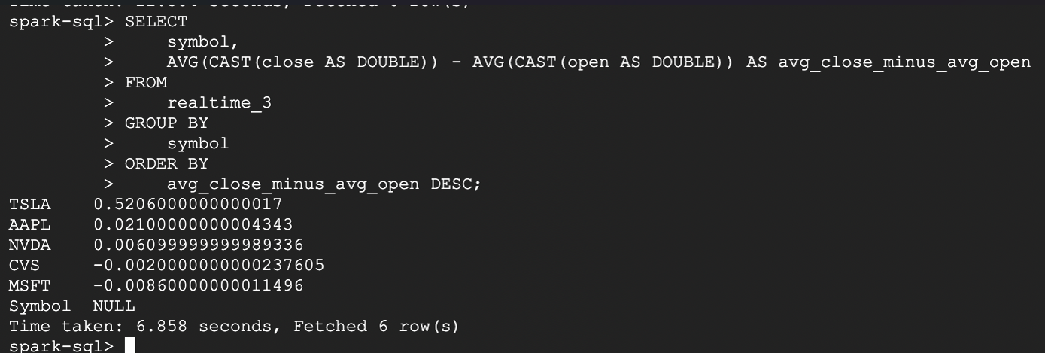
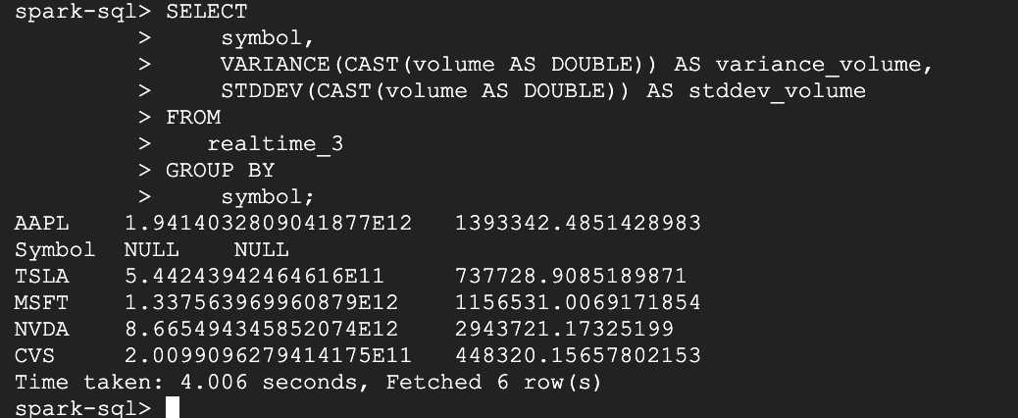
Spark
After analyzing the stock news sentiment table, we then analyzed the real-time stock data using Apache Spark.
Fig 18-shows that the daily stock price difference across the stocks. From the result, it reveals that Tesla has the highest price difference due to its positive sentiment score (as mentioned in previous slide).
Fig 19-shows that the standard deviation of the stocks. From the result, it reveals that Tesla has the highest variance and std dev refers higher volatility.

Slide 17
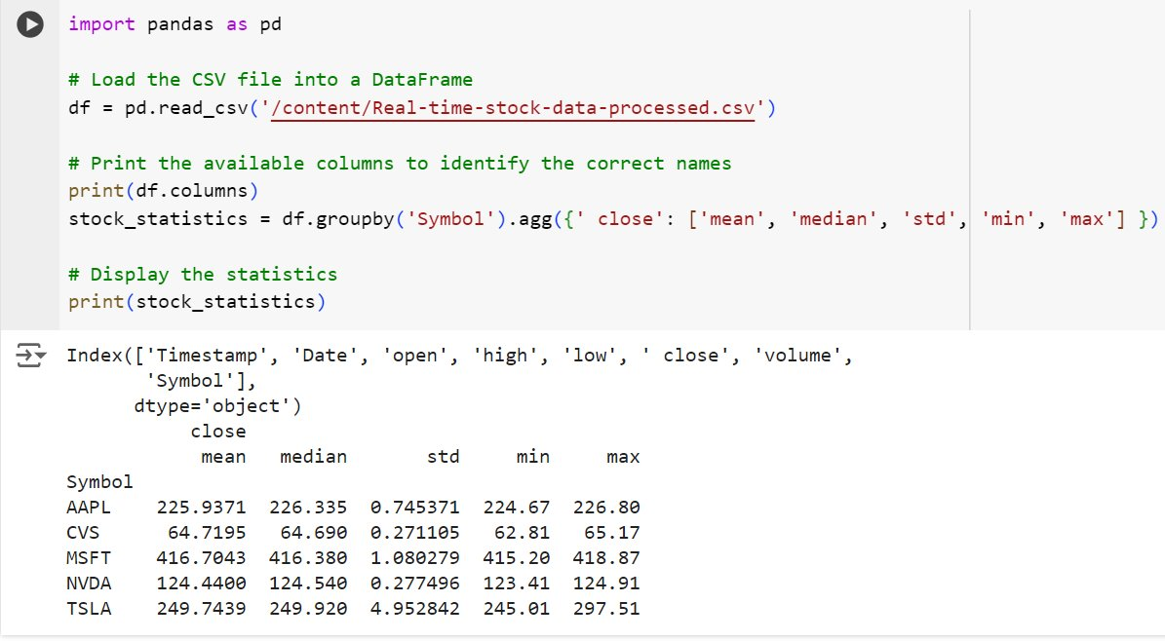
Statistics of Real-time Stock data
Crucial information data about stock performance and sentiment were analyzed by finding the complete statistics of the stocks using Python.​
Key findings: ​
This analysis revealed how sentiment correlates with stock metrics. ​
Mean & Median Prices – Reflect overall stock health​.
Standard Deviation – Indicates price fluctuations and risk.
Min & Max – Represents the real-time stock growth on the same day. ​

Slide 18
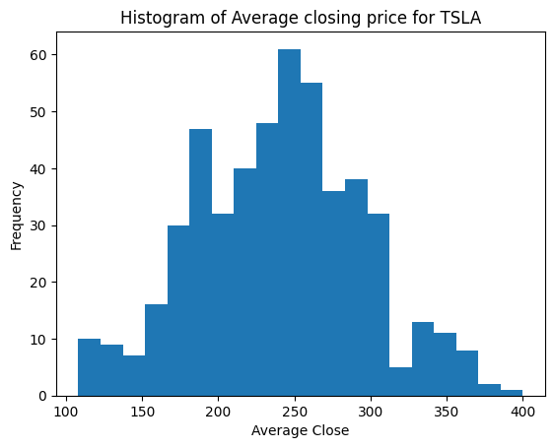
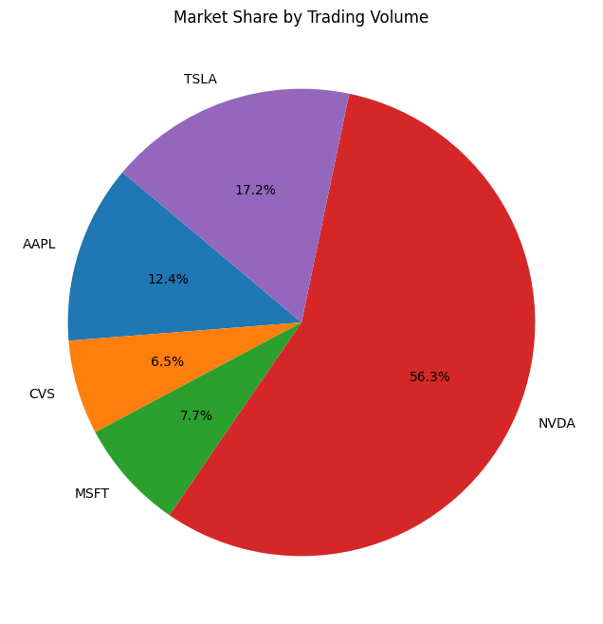
Data Visualization
Both static, streaming data analyzed in the previous sections are put to visualizations for easier understanding.
Historic Financial Market Data
Fig 20-The above histogram represents the symmetric distribution with the average stock price of TSLA stays between 200 and 300 USD in 2022 - 2023 .
Fig 21-The above pie chart shows that the trading volume of NVDA is higher than other stocks which confirms with our analysis.

Slide 19
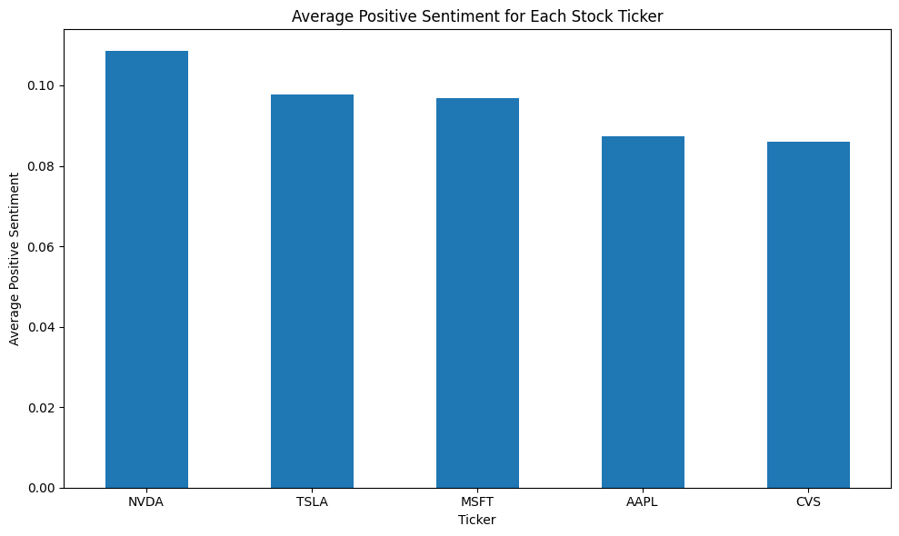
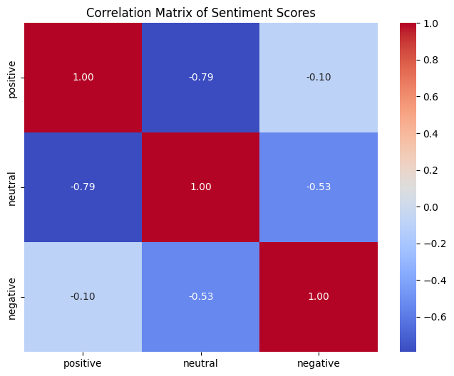
Real-time News Data
Fig 22-The above bar chart represents the average positive sentiment score for each stock. From the above chart, we can understand that the NVDA has the highest average positive sentiment score.
Fig 23-The above heatmap represents the correlation matrix of positive, neutral, and negative sentiment scores.

Slide 20
Interpretation
Stock Performance Trends: Consistent Growth ​
In 2022, NVDA showed a steady increase in stock price even when the market for other stocks was unpredictable. ​
Sentiment Analysis: Market Perception​
Sentiment scores showed that favorable news affects stock performance.​ Tesla’s positive sentiment score, increased its stock price, whereas the neutral score of CVS didn’t alter its stock price.
Visual Insights: Price Stability​
TSLA's average stock price remained between 200-300 USD, while NVDA's trading volume was notably higher, confirming its strong market presence.​
Strategic Implications: Investment decisions​
The correlation between sentiment and stock price emphasizes the importance of factoring in market perception with performance metrics for better informed investment decisions.​
Conclusion - Combining statistical analysis, sentiment assessment, and visual data gives a complete picture of how stocks are performing, providing useful information for planning future investments.

